Slide 1
Current Simulations
12/6/2023
Christina Zhou

Slide 2
Simulation Settings
Trained on censored data; evaluated on test data with NO censoring.
200 simulations per setting
Sample Size: N = 400 vs N = 1000
evaluation size N = 10,000
Cause 1 probability: p = 0.3 vs p = 0.6
Betas: 4 different scenarios (see next slide)
Propensity: observational vs RCT
Number of Causes: 2

Slide 3
Betas (4 scenarios: low ncov, low ncov2, high ncov, high ncov2)
beta1 =
list(beta1.hazard0 = c(0, 1 * c(2,2,2)),
beta1.hazard1 = c(0, -1 * c(0.5,0.5,0.5)),
beta2.hazard0 = c(0, -1 * c(0.5,0.5,0.5)),
beta2.hazard1 = c(0, 1 * c(1,1,1))),
beta2 =
list(beta1.hazard0 = c(0, 1 * c(rep(2,2,2,2,2))),
beta1.hazard1 = c(0, -1 * c(rep(0.5,0.5,0.5,0.5,0.5))),
beta2.hazard0 = c(0, -1 * c(rep(0.5,0.5,0.5,0.5,0.5))),
beta2.hazard1 = c(0, 1 * c(rep(1,1,1,1,1)))),
beta3 =
list(beta1.hazard0 = c(0, 1 * c(2,2.1,2.1)),
beta1.hazard1 = c(0, -1 * c(0.4,0.3,0.6)),
beta2.hazard0 = c(0, -1 * c(0.5,0.3,0.3)),
beta2.hazard1 = c(0, 1 * c(1,0.9,1.3))),
beta4 =
list(beta1.hazard0 = c(0, 1 * c(2,2.1,2.2,2.3,2.1)),
beta1.hazard1 = c(0, -1 * c(0.4,0.4,0.3,0.3,0.6)),
beta2.hazard0 = c(0, -1 * c(0.5,0.4,0.5,0.3,0.3)),
beta2.hazard1 = c(0, 1 * c(1.1,1,0.8,0.9,1.3)))

Slide 4
Truncated mean side by side: Overall survival (left) and endpoint (right)
Each dot is a simulation in that setting. N.sim = 200.
Mean 1) overall survival or 2) cause 1 survival time amongst everyone who observes it
We want higher values for everything because we want treatment that gives higher survival times.
Notes:
This is for truncated mean only

Slide 5
Probability side by side: Overall survival (left) and CIF (right)
Each dot is a simulation in that setting. N.sim = 200.
1) overall survival probability at time 3 or 2) cause 1 cumulative incidence at time 3 amongst everyone who observes cause 1
We want higher values for survival because we want treatment that gives higher survival probability
We want lower values for endpoint because we want treatment that gives lower cumulative incidence of priority cause

Slide 6
Overall Survival Time (Left: truncated mean; Right: probability at time 3)
Notes:
overall survival for both truncated mean and probability at time t0

Slide 7
Cause 1 Survival Time: We want it to be high because this is failure time from cause 1.
Notes:
cause 1 time for both truncated mean and probability at time t0

Slide 8
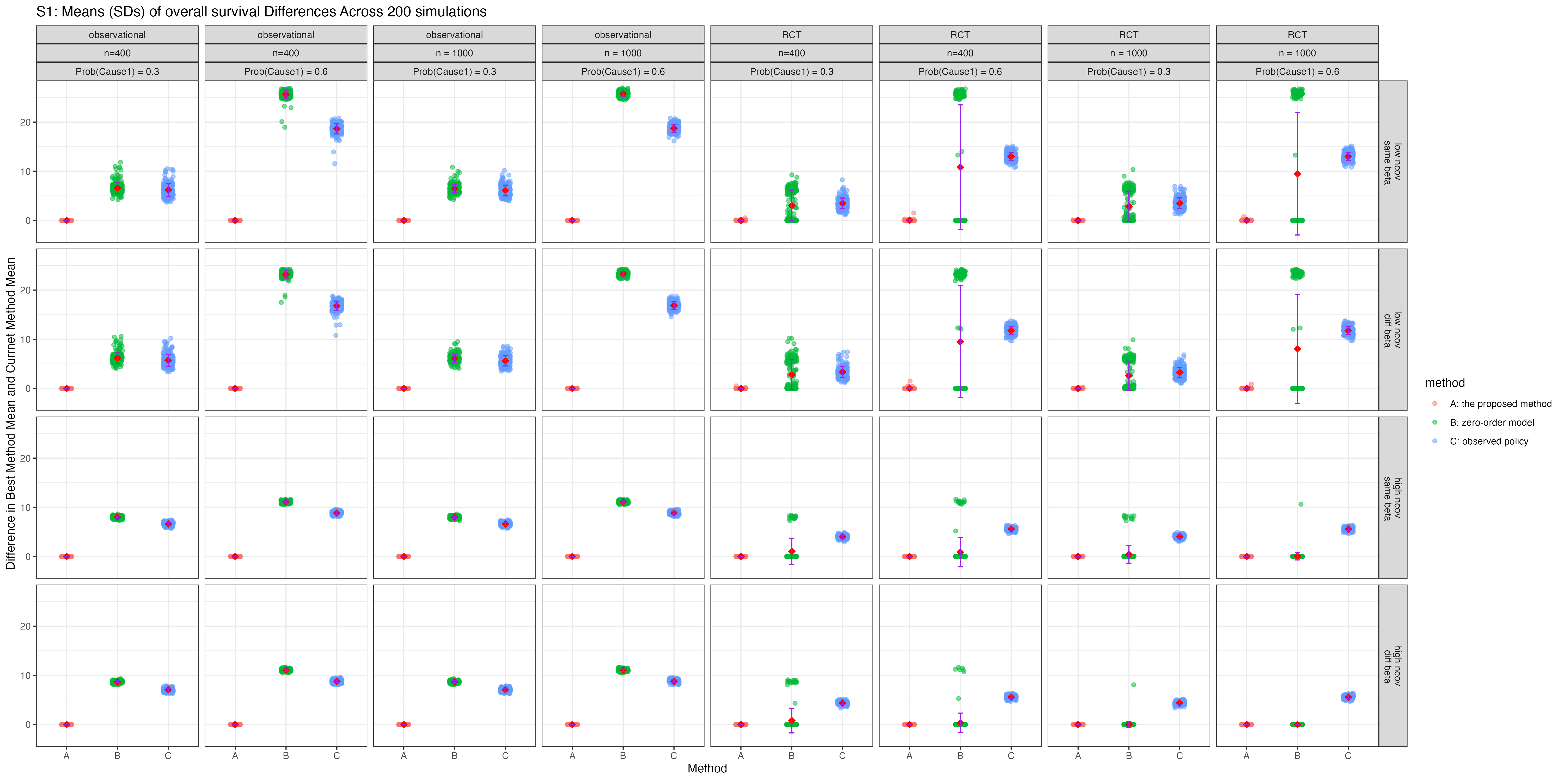
Figure S1: Overall survival: distribution of differences across 200 simulations (between Method and BEST METHOD). NOTE: closer to 0 is better.
Notes:
NOTE: closer to 0 is better. 0 means it was the TOP PERFORMER of that simulation
when we aren’t the top performer in terms of survival, what is the error / how much worse is it than the top performer in survival (shouldn’t be that much worse).
^ for one simulation, calculate overall survival summary statistic and do that for each of the methods, then pick the largest and then for each of the methods, take the largest minus each method.
see if its within alpha.;
^ then do mean and variance across simulations. mean is the regret for survival and regret for primary cause.
^ we want a smaller mean b/c we want closer to best.

Slide 9
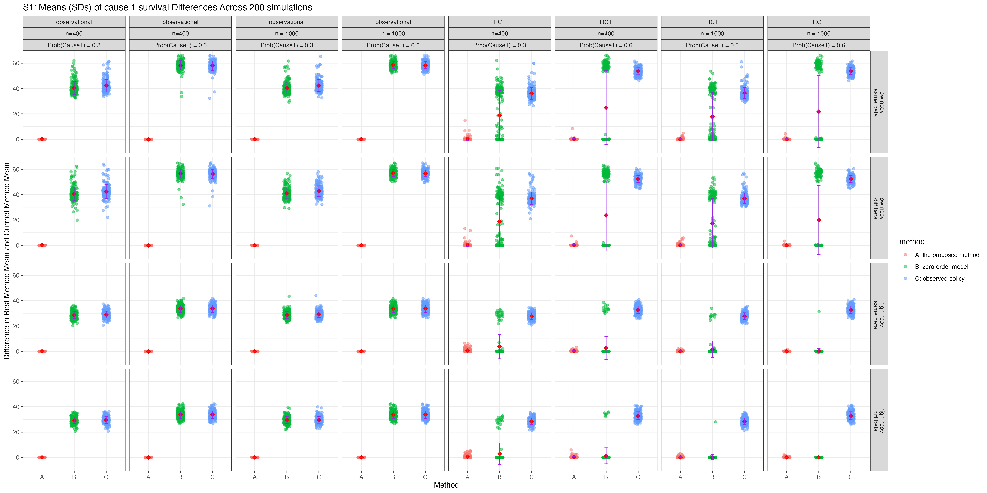
Overall cause 1: distribution of differences across 200 simulations (between Method and BEST METHOD)
Notes:
Do the same for primary CR (primary cause).

Slide 10
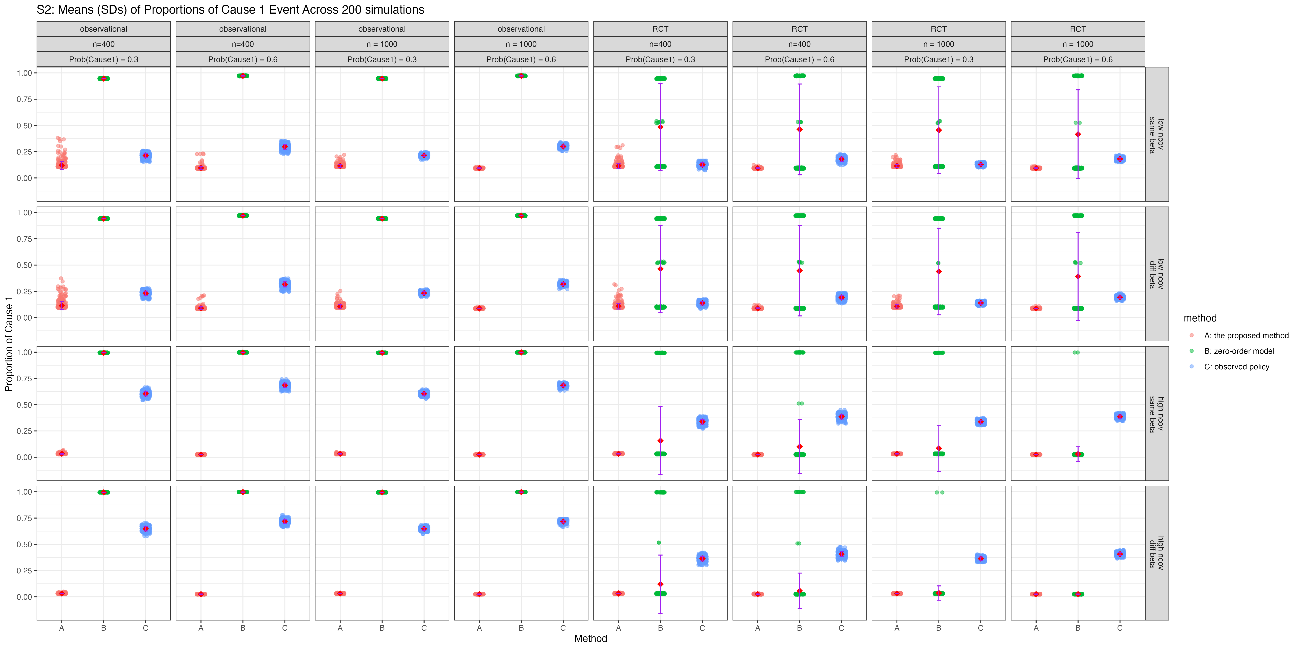
Mean/SD and distribution of Proportion of Subjects Experiencing Cause 1 first
Lower is better since the goal is to minimize cause 1 (priority CR) failures when we move to Phase 2 of method.

Slide 11
Next Steps
Simulation
Real World Analysis
Implement H. Cho’s dtrSurv into simulations
eventually add in other methods as well
Add in censoring to training dataset
add in observation data
CLTI PAD dataset: modify to one row per subject (first amputation from any wound to occur before death = amputation)
composite outcome of death and amputation
primary CR would be amputation
See if there are any other datasets

